Slide 1

Digital System Design Course
Notes:
1
1

Slide 2
Diseño de Máquinas de Estado Síncronas Tipo Mealy
Notes:
2

Slide 3
Motor DC
Diseñar una FSM para controlar un motor DC:
El motor arranca y gira en sentido normal cuando detecta la secuencia X: 1, 1, 1, 0.
El motor arranca y gira en sentido inverso cuando detecta la secuencia X: 1, 0, 0, 1.
El motor se detiene después de arrancar, si el circuito detecta la secuencia 0, 1, 1, 1 y permanece detenido hasta detectar de nuevo la secuencia de arranque.
Sin embargo, después de arrancar el motor, cada vez que el circuito detecta la secuencia X: 1, 0, 1, 0 el motor debe girar en sentido contrario, pero primero debe parar un instante.
Existe superposición, usar Flip-Flop D y codificación directa.

Slide 4

Diagrama de Estados
Secuencia | Salida | Giro del motor
1110 | 01
1001 | 10
0111 | 00
1010 | 00* | S. Contrario
FF-D
Q | Q* | D
0 | 0 | 0
0 | 1 | 1
1 | 0 | 0
1 | 1 | 1
15 Estados
4 FFs-D
Q*=D

Slide 5
Tabla de Estados
EP |  |  |  |  | PE |  |  |  |  |  |  |  | Salida
 |  |  |  |  | X=0 |  |  |  | X=1 |  |  |  | X=0 |  | X=1
 | Q₃ | Q₂ | Q₁ | Q₀ | D₃ | D₂ | D₁ | D₀ | D₃ | D₂ | D₁ | D₀ | Z₁ | Z₀ | Z₁ | Z₀
S₀ | 0 | 0 | 0 | 0 | 0 | 0 | 0 | 0 | 0 | 0 | 0 | 1 | 0 | 0 | 0 | 0
S₁ | 0 | 0 | 0 | 1 | 0 | 1 | 0 | 0 | 0 | 0 | 1 | 0 | 0 | 0 | 0 | 0
S₂ | 0 | 0 | 1 | 0 | 0 | 1 | 0 | 0 | 0 | 0 | 1 | 1 | 0 | 0 | 0 | 0
S₃ | 0 | 0 | 1 | 1 | 0 | 1 | 1 | 0 | 0 | 0 | 1 | 1 | 0 | 1 | 0 | 0
S₄ | 0 | 1 | 0 | 0 | 0 | 1 | 0 | 1 | 0 | 0 | 0 | 1 | 0 | 0 | 0 | 0
S₅ | 0 | 1 | 0 | 1 | 0 | 0 | 0 | 0 | 1 | 0 | 1 | 0 | 0 | 0 | 1 | 0
S₆ | 0 | 1 | 1 | 0 | 0 | 1 | 1 | 1 | 1 | 0 | 0 | 1 | 0 | 1 | 0 | 1
S₇ | 0 | 1 | 1 | 1 | 0 | 1 | 1 | 1 | 1 | 0 | 0 | 0 | 0 | 1 | 0 | 1
S₈ | 1 | 0 | 0 | 0 | 0 | 1 | 1 | 0 | 0 | 0 | 1 | 1 | 0 | 1 | 0 | 1
S₉ | 1 | 0 | 0 | 1 | 1 | 0 | 1 | 1 | 0 | 0 | 1 | 1 | 0 | 0 | 0 | 1
S₁₀ | 1 | 0 | 1 | 0 | 1 | 0 | 1 | 1 | 1 | 1 | 0 | 0 | 1 | 0 | 1 | 0
S₁₁ | 1 | 0 | 1 | 1 | 1 | 1 | 1 | 0 | 1 | 1 | 0 | 1 | 1 | 0 | 1 | 0
S₁₂ | 1 | 1 | 0 | 0 | 1 | 0 | 1 | 1 | 0 | 0 | 1 | 1 | 1 | 0 | 0 | 0
S₁₃ | 1 | 1 | 0 | 1 | 0 | 1 | 1 | 0 | 1 | 1 | 0 | 0 | 0 | 0 | 1 | 0
S₁₄ | 1 | 1 | 1 | 0 | 1 | 1 | 1 | 0 | 1 | 0 | 1 | 0 | 1 | 0 | 1 | 0

Slide 6
Mapas K
XQ₃Q₂
Q₁Q₀
000
001
011
010
110
111
101
100
00
0 | 0 | 1 | 0 | 0 | 0 | 0 | 0
0 | 0 | 0 | 1 | 0 | 1 | 1 | 0
0 | 0 | X | 1 | 1 | X | 1 | 0
0 | 0 | 1 | 1 | 1 | 0 | 1 | 0
01
11
10
D₃
D₃=X·Q₂·Q₀ + Q₃·~Q₂·Q₁ + X·~Q₃·Q₂·Q₁
+ ~X·Q₃·Q₂·~Q₀ + ~X·Q₃·~Q₂·Q₀

Slide 7
Mapas K
XQ₃Q₂
Q₁Q₀
000
001
011
010
110
111
101
100
00
0 | 1 | 0 | 1 | 0 | 0 | 0 | 0
1 | 0 | 1 | 0 | 0 | 1 | 0 | 0
1 | 1 | X | 1 | 1 | X | 0 | 0
1 | 1 | 1 | 0 | 1 | 0 | 0 | 0
01
11
10
D₂
D₂= ~X·Q₁·Q₀ + Q₃·Q₂·Q₀ + ~X·Q₂·Q₁ + ~X·Q₃·~Q₂·~Q₁·~Q₀
+ ~X·~Q₃·Q₁ + X·Q₃·~Q₂·Q₁ + ~X·~Q₃·~Q₂·Q₀ + ~X·~Q₃·Q₂·~Q₀

Slide 8
Mapas K
XQ₃Q₂
Q₁Q₀
000
001
011
010
110
111
101
100
00
0 | 0 | 1 | 1 | 1 | 1 | 0 | 0
0 | 0 | 1 | 1 | 1 | 0 | 1 | 1
1 | 1 | X | 1 | 0 | X | 0 | 1
0 | 1 | 1 | 1 | 0 | 1 | 0 | 1
01
11
10
D₁
D₁=Q₃·Q₂·~Q₀ + Q₃·~Q₂·~Q₁ + ~X·Q₁·Q₀
+ ~X·Q₂·Q₁ + ~X·Q₃ + X·~Q₃·~Q₁·Q₀ + X·~Q₃·~Q₂·Q₁

Slide 9
Mapas K
XQ₃Q₂
Q₁Q₀
000
001
011
010
110
111
101
100
00
0 | 1 | 1 | 0 | 1 | 1 | 1 | 1
0 | 0 | 0 | 1 | 1 | 0 | 0 | 0
0 | 1 | X | 0 | 1 | X | 0 | 1
0 | 1 | 0 | 1 | 0 | 0 | 1 | 1
01
11
10
D₀
D₀=Q₂·~Q₁·~Q₀ + X·~Q₁·~Q₀ + X·~Q₂·Q₁·Q₀
+ ~X·~Q₃·Q₂·Q₁ + Q₃·~Q₂·~Q₁·Q₀ + X·~Q₃·~Q₀
+ ~X·Q₃·~Q₂ ·Q₁·~Q₀

Slide 10
Mapas K
XQ₃Q₂
Q₁Q₀
000
001
011
010
110
111
101
100
00
0 | 0 | 1 | 0 | 0 | 0 | 0 | 0
0 | 0 | 0 | 0 | 0 | 1 | 1 | 0
0 | 0 | X | 1 | 1 | X | 0 | 0
0 | 0 | 1 | 1 | 1 | 1 | 0 | 0
01
11
10
Z₁
Z₁=Q₃·Q₁ + X·Q₂·~Q₁·Q₀ + ~X·Q₃·Q₂·~Q₀

Slide 11
Mapas K
XQ₃Q₂
Q₁Q₀
000
001
011
010
110
111
101
100
00
0 | 0 | 0 | 1 | 1 | 0 | 0 | 0
0 | 0 | 0 | 0 | 1 | 0 | 0 | 0
1 | 1 | X | 0 | 0 | X | 1 | 0
0 | 1 | 0 | 0 | 0 | 0 | 1 | 0
01
11
10
Z₀
Z₀=~Q₃·Q₂·Q₁ + ~X·~Q₃·Q₁·Q₀ + X·Q₃·~Q₂·Q₁
+ Q₃·~Q₂·~Q₁·~Q₀

Slide 12
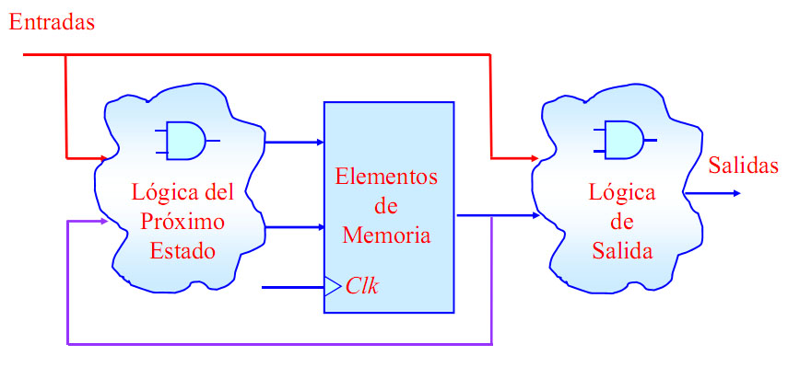
Implementación General

Slide 13
Diseño de Máquinas de Estado Síncronas Tipo Mealy
Francisco Gómez 0738104
Notes:
13

